Slide 1
INVENTORY MANAGEMENT SYSTEM
Software engineering min project work

Slide 2
ABSTRACT
Inventory system which is helpful for the business operators, where shopkeeper keep the records of purchase and sales . This inventory is eliminate paper work, human faults , manual delay and speed up process .This inventory system will have the ability to track sales and available inventory, tells a shopkeeper when it’s time to reorder and how much to purchase. Inventory management system is windows application developed for windows operating systems which focused in the area of inventory control and generate .

Slide 3
.
Context
1. INTRODUCTION
1.1 PURPOSE
1.2.SCOPE
1.3 NEEDS FOR INVENTORY SYSTEM
1.3.1: EXISTING SYSTEM FOR INVENTORYSYSTEM
1.3.2: EXISTING SYSTEM FOR DISADVANTAGES
2.Software Requirements Analysis &Specifications
2.1 Product perspective
2.2 Product function
2.3 User Characterstics
2.4 modules
2.5 functional and non-functional requirements
2.5.1 functional requirements
2.5.2 non functional requirements
2.6 system specifications
2.6.1 hardware requirements
2.6.2 software requirements
2.7 software development cycle
2.7.1waterfall model
2.8 system study
2.9 methodoogy and algorithm
2.10 technmology used

Slide 4
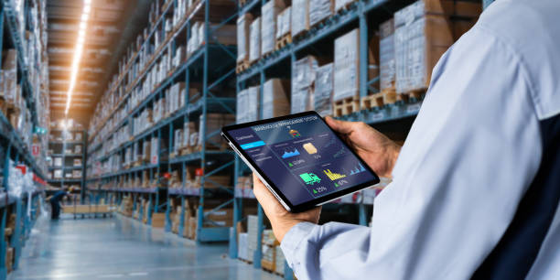
1.1 PURPOSE
Inventory management system is essential for running a profitable and Prosperous business. It’s an inseparable component for retail, Wholesale, e-commerce, or manufacturing organization. Inventory occupies an impressive Percentage of any business’s total financial assets.

Slide 5
1.2 Scope
Demand management Forecasting future Demand requirements.
Managing items with difficult supply and demand Patterns.
Reviewing Safety Stock levels. Implementing lean inventory Policies.
Appropriate disposal of Scrap, surplus and Obsolete items.

Slide 6
1.3 NEEDS OF INVENTORY SYSTEM
Inventory management are facilitates the smoot functioning of your business and enhancing sales and improves customer experience.
Listed below ,Why business needed inventory system:
1. Managining finance: It helps business understand , which product are more valuable in sales and earning profit
2. Tracking inventory: it provides the complete detailing of an inventory and its location
3. Avoiding late delivery: stock out result in late delivery ,the customer can unhappy .This can helps in Improving customer experiences thus increasing sales.

Slide 7
1.3.1 EXISTING SYSTEM FOR INVENTORY SYSTEM
An existing inventory system typically refer to software or platforms used to manage and track the flow of goods , materials , and products within a business these systems are designed to help businesses efficiently manage inventory levels, track levels , monitorstack , and optimize the supply
• Manual system
• Barcode/ QR code based system
• Cloud based inventory system
• Enterprise resource planning (ERP) system

Slide 8
1.3.2 EXISTING SYSTEM DIS-ADVANTAGES
• Loss of stack
• Improper inventory tracking
• Cost
• Need for physical inventory

Slide 9
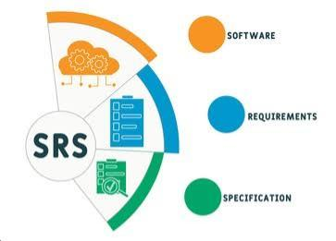
2. SOFTWARE REQUIREMENTS SYSTEM
Requriments Anaysis
Requirement Analysis presents the requirement specification, software and hardware requirements for both system developers and system users, process model and data model. In this section we specify the External Interface Requirements, functional and non-functional requirements of the system

Slide 10
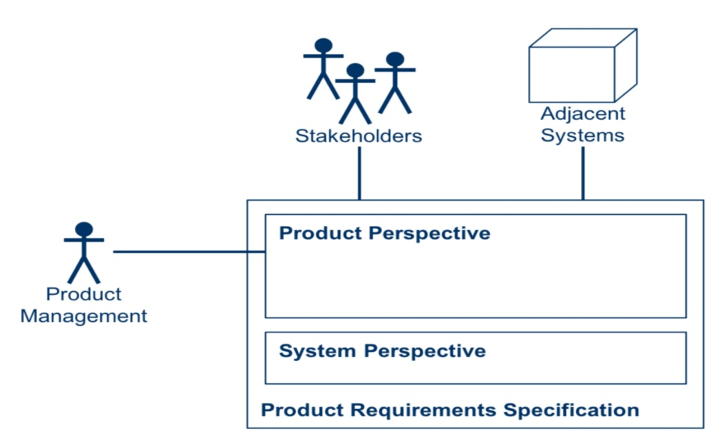

2.1 Product Perspective From a product perspective, an inventory system aims to ensure the right products are available in the right quantities at the right time, optimizing stock levels, minimizing costs, and improving customer satisfaction
2.2 PRODUCT FUNCTION
An inventory system's product function involves managing the flow of goods, from raw materials to finished products, ensuring timely availability to meet customer demand and optimize operations.

Slide 11
2.3 USER CHARACTERSTICKS
Inventory systems should be scalable, flexible, and provide real-time information. They should also have the ability to track inventory across multiple locations and warehouses.
Real-time tracking: Inventory systems should provide real-time visibility into inventory movement across the supply chain.
Automated reordering Inventory systems should automatically notify users when inventory reaches preset thresholds.
Demand forecasting: Inventory systems should use historical sales data to predict future customer demand.

Slide 12

2.4 MODULES
1. Inventory Tracking: Monitors stock levels, item locations, and movement in real-time.
2. Order Management: Manages sales orders, purchase orders, and stock transfers.
3. Product Information Management: Stores and manages product details, such as descriptions, pricing, and supplier information.
4. Warehouse Management: Oversees warehouse operations, including receiving, storing, and shipping.
5. Reporting and Analytics: Provides insights into inventory performance, sales trends, and supply chain efficiency.

Slide 13
.
2.5 FUNCTIONAL AND NON FUNCTIONAL REQUIREMENTS:
2.5.1 Functional Requirements :
Functional requirements define what a software system should do, as well as its features and functions. It specifies a module’s or a system’s function
Functionality is determined by comparing a set of inputs to the system under test to the system’s output. Functional requirements thereby describe a certain system outcome when a task is carried out on them by the user..
Functions of authentication:
They have to do with the data users divulge to the system and the amount of authentication they utilize.
Levels of authorization: These operations choose who can CRUD (alter, read, update, or delete) information and various system access levels.

Slide 14
.
2.5.2 Non_functional requirements:
Instead of specifying “what a system should do,” the Non-functional requirements talk about “what a system should be ” (functional requirements). Non-functional requirements describe a system’s general properties. They are also referring to as quality characteristics.
Extensibility
It is the capacity to extend a system and the amount of work required to do so. Utilize Nvntri to become more efficient and save time.
Reliability
The chance and percentage of the software working without failure for a given number of uses or period of time is referred to as reliability. Manage things stress-free, to become more efficient and save time with Nvntri

Slide 15
.
2.6SYSTEM SPECIFICATIONS:
2.6.1 HARDWARE REQUIREMENTS:
1. Servers and Computers:
For On-Premise Systems: You'll need servers (and potentially workstations) with sufficient processing power, memory, and storage to run the inventory management software and store data, according to Activate.
For Cloud-based Systems: You'll primarily need devices (like computers, laptops, or mobile devices) to access the software through a web interface, says Unleashed Software.
2. Barcode Scanners and Printers:
Barcode scanners:. Used for quickly and accurately tracking inventory, especially in warehouses or retail settings, according to Unleashed Software

Slide 16
.
2.6.2 SOFTWARE REQUIREMENTS:
An effective inventory management software system requires functionalities for tracking, forecasting, and reporting, along with integrations for seamless operation. Key features include real-time visibility of stock levels, automated processes, and user-friendly interfaces.
1. Core Inventory Management Features:
Real-time Inventory Tracking: The system should provide a clear and up-to-date view of all inventory items, including their quantities, locations, and movement.
Automated Processes: Minimizing manual tasks through automation for processes like stock adjustments, purchase orders, and replenishment.
2. Data Management and Security:
Accurate Databases: Ensure the integrity and accuracy of inventory data
Notes:
Software engineering document 26-05-2025 lab session

Slide 17
2.7 Software Development Life Cycle (SDLC):
2.7.1 Waterfall Model :
The project follows the Waterfall model, a linear and sequential approach:
Requirement Analysis: Gathering all system requirements.
System Design: Designing system architecture and components.
Implementation: Coding and development of modules.
Testing: Verifying and validating the system.
Deployment: Launching the system for end-users.

Slide 18
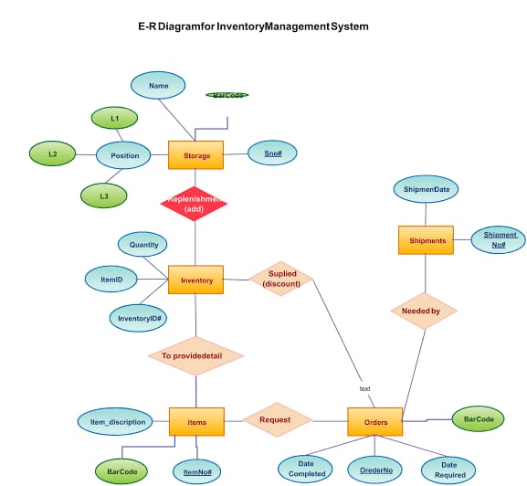
.
2.8 System Study: The study involved analyzing existing inventory management methods, identifying bottlenecks like manual errors and delays, and defining system goals to automate and improve accuracy.

Slide 19
.
2.9 Methodology and Algorithm:
The system uses algorithms for stock management such as:
Reorder Level Checking: When stock quantity = reorder level, trigger alert.
Stock Update Algorithm: Automatically adjust stock quantities on sales or purchases
Report Generation: Query database and summarize inventory status.

Slide 20
.
2.10 Technology Used Frontend:
React.js or Angular for responsive UI
Backend: Node.js with Express or Django framework.
Database: MySQL for reliable data storage.
Version Control: Git for source code management.
Deployment: Hosted on cloud platforms like AWS or Azure.

